Slide 1
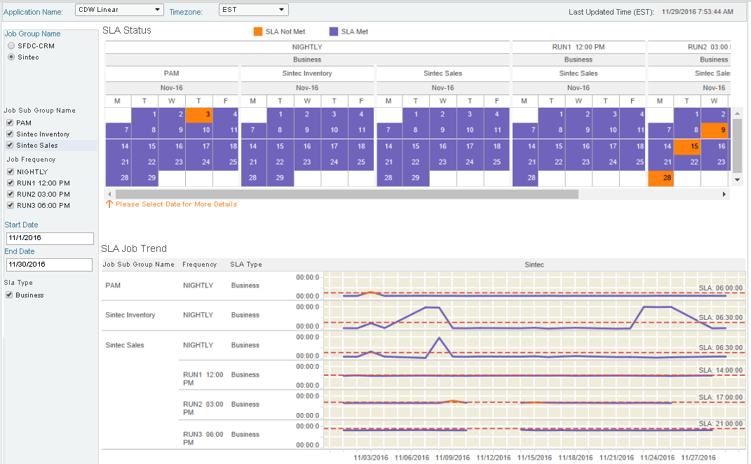
EACS Dashboard – Trend Analysis

